Slide 1
Celebration Presentation
By: Aman Pandita

Slide 2
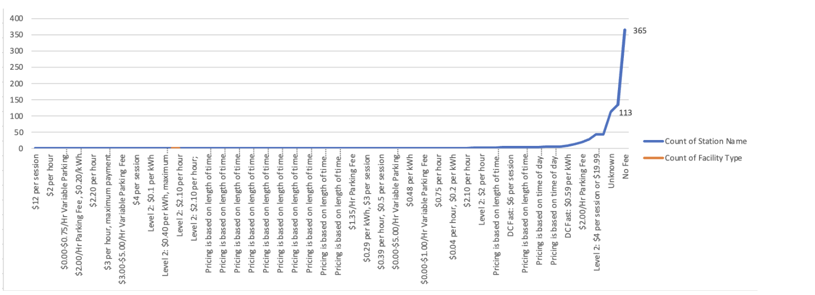
My initial analysis and visualization:

Slide 3
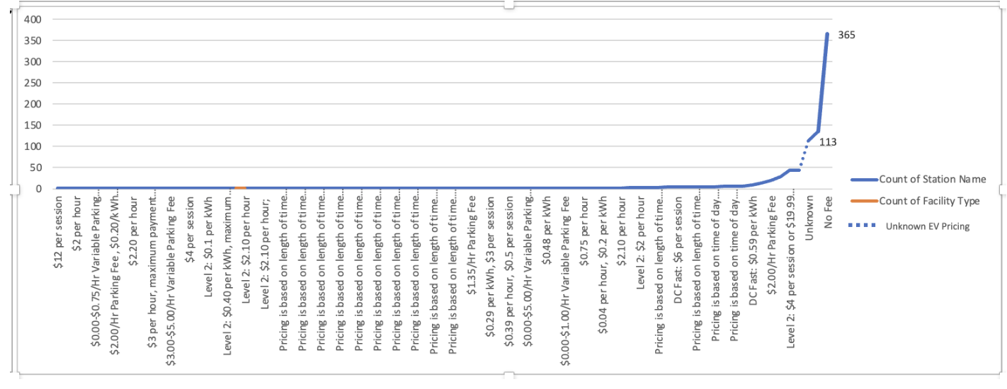
My initial analysis and Uncertainty visualization:

Slide 4
Comparing the charging Infrastructure of Tesla vs Other Brands.
With the help of improving my visualization knowledge due to Project 1 & 2, i was able to find a key insight towards what could be a future discussion about Ev adoption in Oregon. The EV adoption rate in Oregon has been experiencing exponential growth, with Tesla playing a prominent role in the market. However, one key challenge remains: the lack of Tesla charging infrastructure in many remote areas across the state.
Furthermore, Tesla's focus has primarily been on major cities in Oregon, overlooking other attractive regions like the Oregon Coast and eastern Oregon. As a result, Tesla owners in these areas are constrained to using traditional charging stations, leading to significantly longer charging times.
“Tesla’s Super Charging stations vs Normal Ev Chargers”

Slide 5
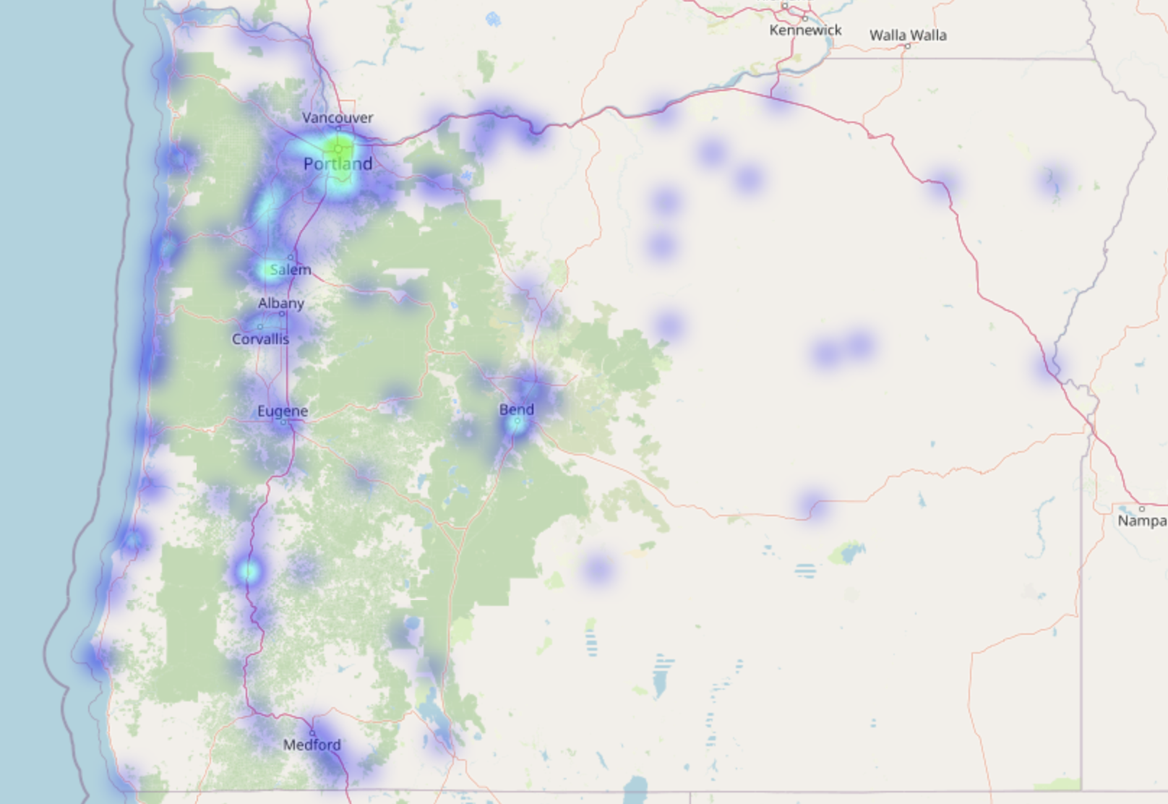
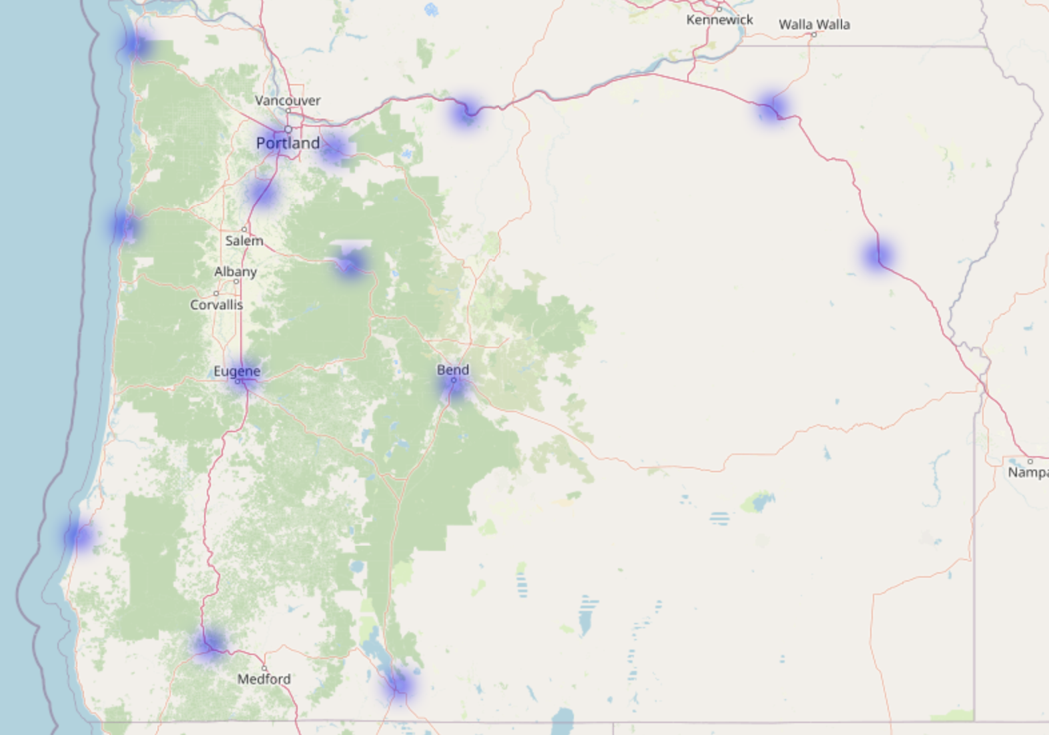
Due to this uncertainty, I was able to visualize a pattern between non Tesla network charging stations vs Tesla Super Chargers
Non Tesla Charging Stations
Tesla Charging Stations

